Slide 1
Team 41
Multiple artifact removal from degraded images using CNN-ViT hybrid architecture
Tejas Dhopavkar • 7075870 | Panav Raina • 7075813

Slide 2
Problem Statement

Slide 3
Problem Statement
Identifying the key concern
Real-world images are often affected by degradations through multiple artifacts.^{[4]}
Models have been trained to generate deblurred images based on either synthetic or natural data.
Few models can tackle multiple degradations simultaneously and can generalize well for both (natural and synthetic) data.

Slide 4
Goals

Slide 5
Goals
We aim to achieve
A model that can handle multiple degradations to produce a clear image.
A model that generalizes well and gives good results on benchmark datasets.

Slide 6
Overview of Approach

Slide 7
Approach
Dataset Collection
Datasets used are GoPro and SIDD.
2
Model Architecture
CNN-ViT Hybrid Architecture, ViT with image patching.
1
3
Model Training
Train the model over GPU’s.
Visualizations
Document loss, visualize attention and features.
5
4
Model Evaluation
Evaluate performance of the model using metrics: PSNR, SSIM

Slide 8
Related Work

Slide 9
Related Work
Deep Image Deblurring: A Survey^{[2]}
The authors introduce deblurring as a classic low-level computer vision problem and provide a list of degradations that can affect an image.
The authors also introduce us to various image deblurring and restoration architectures ranging from CNN, GAN, to Transformers while discussing their advantages and disadvantages.
The authors also provide a brief description of the benchmark datasets like GoPro and SIDD.
In addition, the authors also present the comparison between PSNR and SSIM of various models/architectures.

Slide 10
Related Work
DeblurDiff: Real-World Image Deblurring with Generative Diffusion Models. ^{[1]}
Introduces a Latent Kernel Prediction Network with the pre-trained Stable Diffusion model.
Element-wise adaptive convolution is applied to the kernel to preserve the structural information while deblurring.
The kernels are iteratively refined using results from each diffusion step.
The authors created their own dataset of 500,000 data pairs and used the GoPro dataset for evaluation.

Slide 11
Related Work
Restormer: Efficient Transformer for High-Resolution Image Restoration.^{[3]}
The authors propose a modified transformer architecture that focuses on attention across channels instead of spatial dimensions.
They also utilize depth-wise convolutions. In regular CNNs, we apply the same filter across all the channels. However, in the Restormer, the authors apply a different filter to each of the channels before sending the features to compute cross attention.
The Restormer is able to remove all degradations (noise, blur, de-raining, etc) successfully.
The authors utilize the GoPro dataset along with many others for training and testing.

Slide 12
Proposed Approach and Experiments

Slide 13
Dataset
Image Restoration Dataset
GoPro^{[5]} and SIDD^{[6]} were combined.
Synthetic noise, low resolution added to GoPro dataset.
Synthetic blurring, low resolution added to SIDD dataset.
Total samples: 2214 (Training) + 1160 (Testing) = 3374 images.

Slide 14
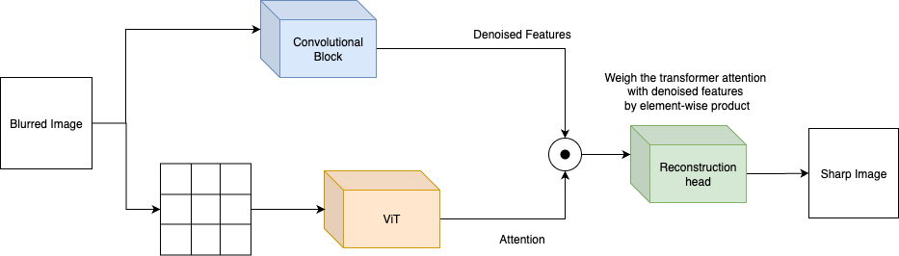
Experiment 1
CNN-ViT Hybrid Architecture

Slide 15
Experiment 1 - Details
Parameter | Value
Epochs | 100
Loss | MSE Loss
Optimizer | Adam Optimizer
Batch Normalization | NA
Hidden layers | 5
Drop Probabilities | 0.4
Transformer Weights | vit-base-patch16-224

Slide 16
Experiment 1 - Configuration
High-Level Structure:
Hybrid model combining Vision Transformer (ViT) and CNN. The CNN extracts the local features and ViT extracts the global features with it’s 12 attention heads. We compute the element-wise product of both features to get weighted-attention.
Key Components:
Custom Dataset: Image Restoration Dataset
Model: CNN-ViT Hybrid Architecture
Loss Function: MSE
Training Pipeline: Extract the features using both branches, compute the product, reconstruct the image, and train the model on MSELoss.
Evaluation & Visualization: Computes PSNR/SSIM, and visualizes input, predicted, and ground-truth images.

Slide 17
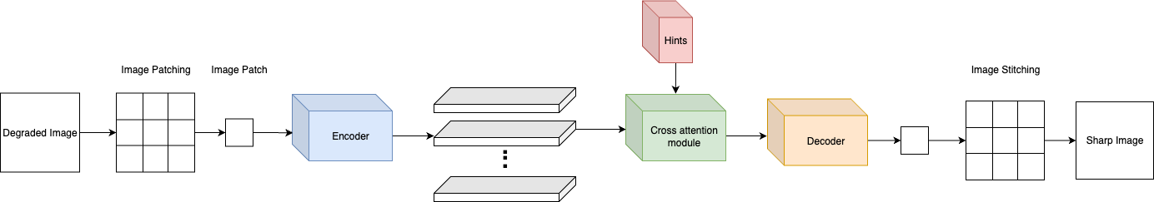
Experiment 2
ViT with Image Patching

Slide 18
Experiment 2 - Details
Parameter | Value
Epochs | 100
Loss | MSE Loss
Optimizer | Adam Optimizer
Batch Normalization | Yes
Drop Probabilities | NA
Transformer Weights | Custom trained weights without initialization

Slide 19
Experiment 2 - Configuration
High-Level Structure:
Hybrid model combining Vision Transformer (ViT) for feature extraction and a convolutional decoder for image reconstruction, enhanced by cross-attention and hint integration.
Key Components:
Custom Dataset: Image Restoration Dataset
Model: End-To-End ViT
Loss Function: MSE
Training Pipeline: Uses gradient accumulation, mixed-precision training, and a ReduceLROnPlateau scheduler for stable convergence.
Evaluation & Visualization: Stitches patches, computes PSNR/SSIM, and visualizes input, predicted, and ground-truth images.

Slide 20
Results

Slide 21
Experiment 1 - Results
Metric | Value
Average Loss | 0.0019663786854552797
Average PSNR | 34.09832070610481
Average SSIM | 0.9226827049563671

Slide 22
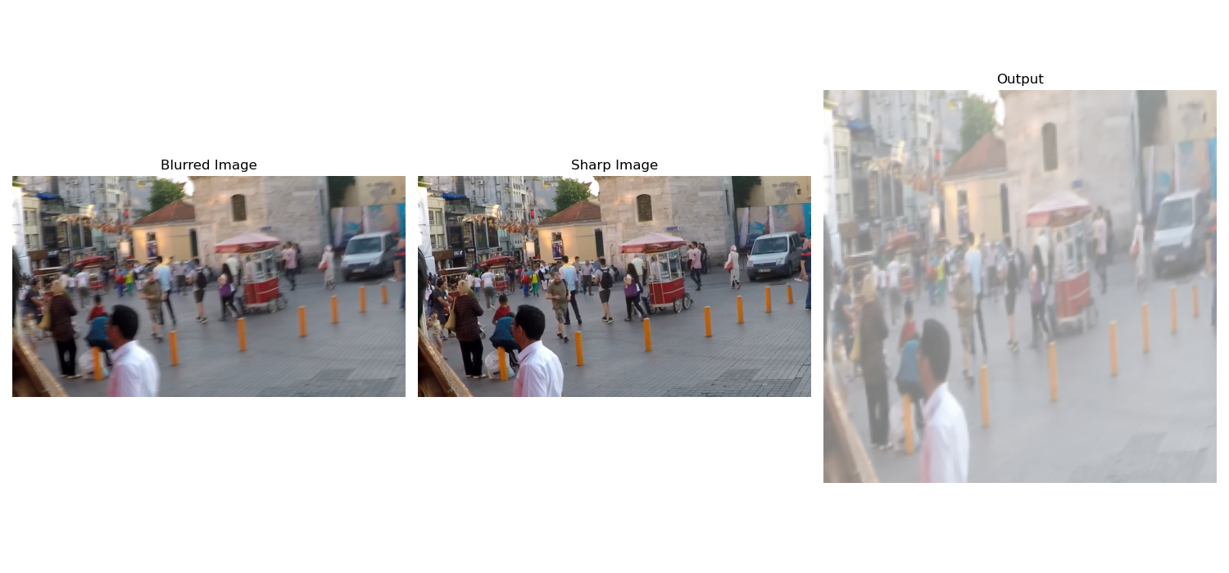
Experiment 1 - Visualizations

Slide 23
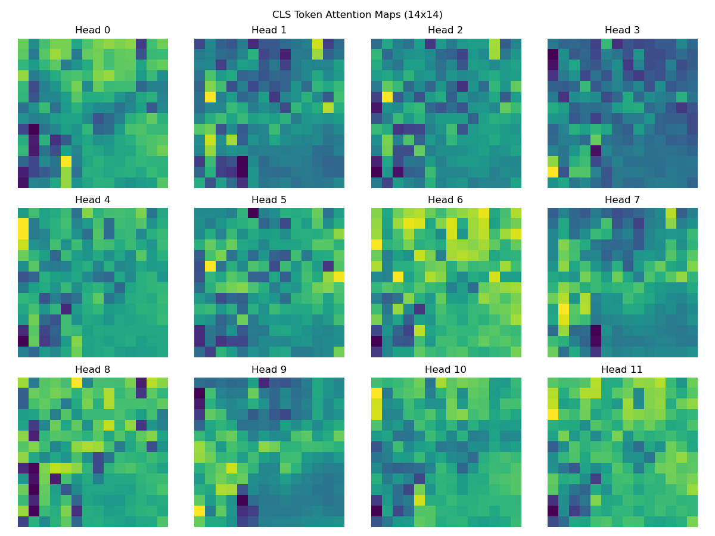
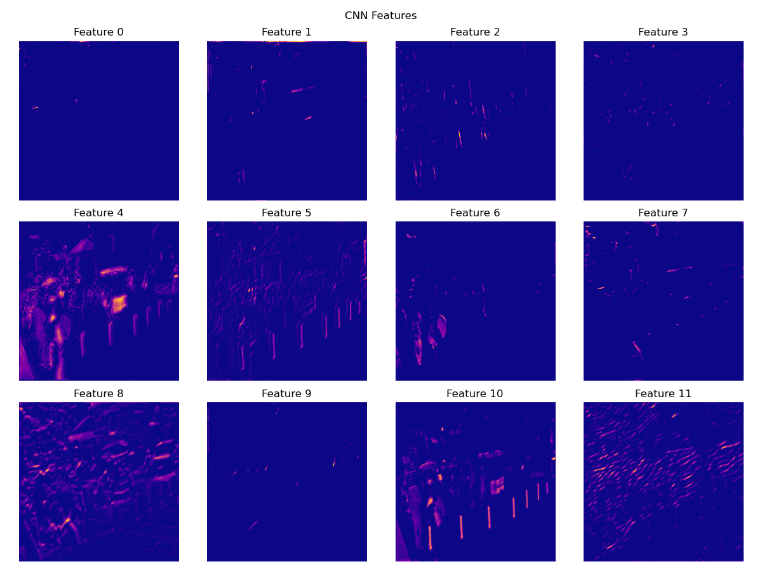
Experiment 1 - Attention and CNN Features

Slide 24
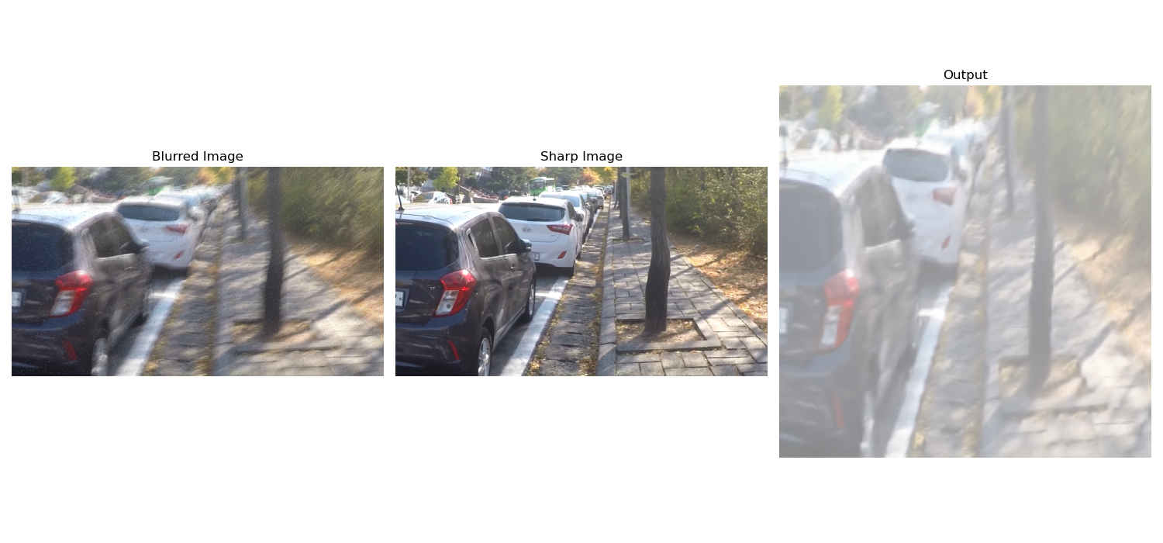
Visualizations - Experiment 1

Slide 25
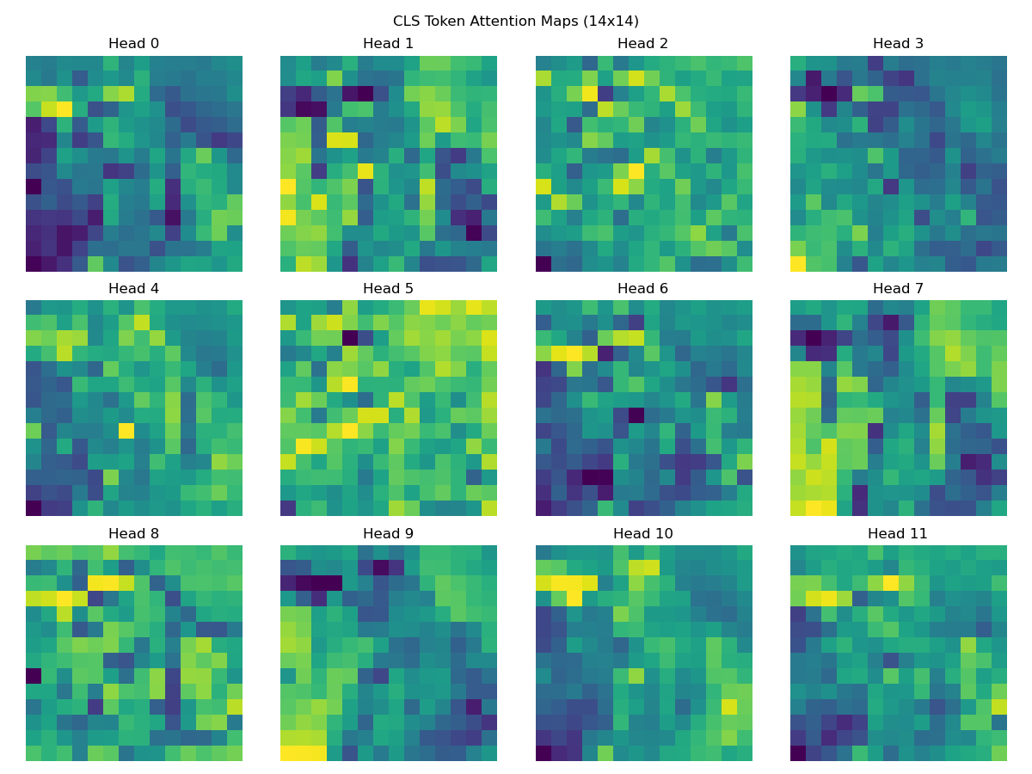
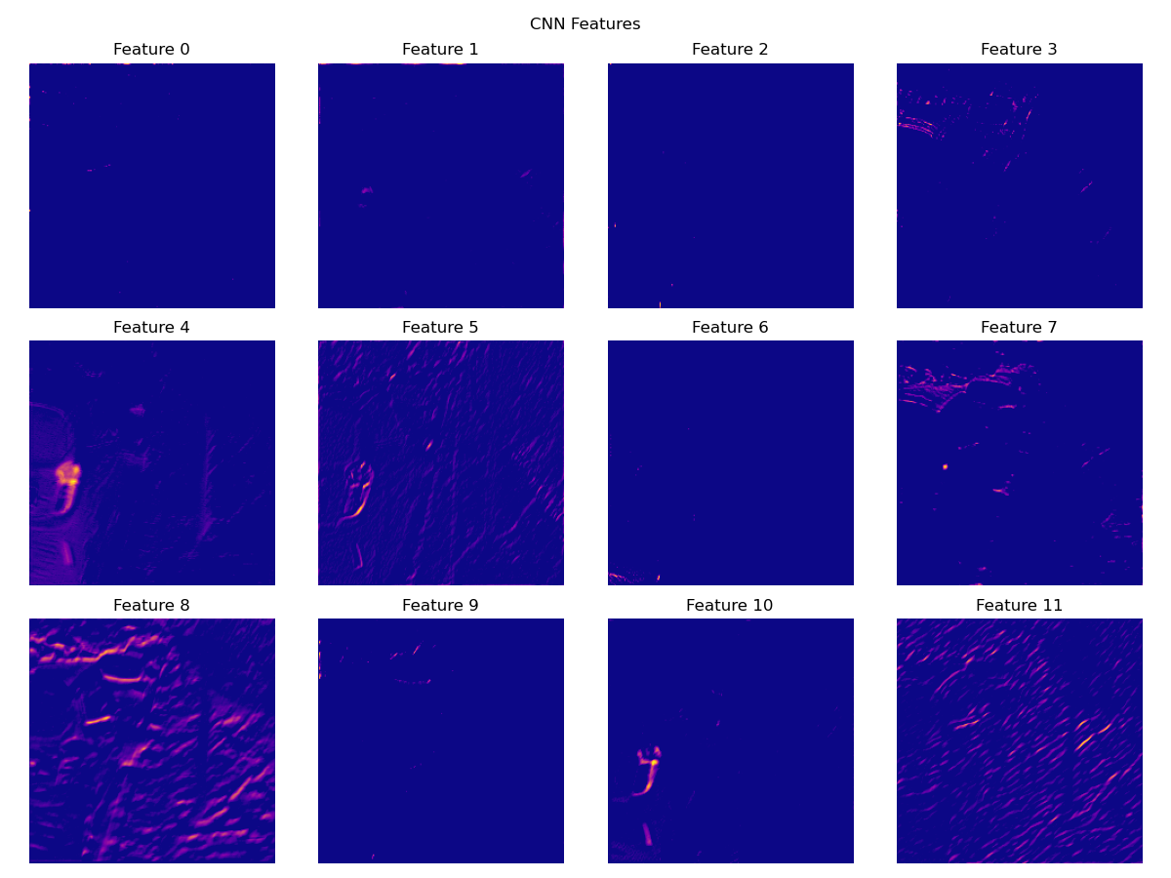
Attention and CNN Features - Experiment 1

Slide 26
Results - Experiment 2
Metric | Value
Average Loss | 0.002
Average PSNR | 30.0
Average SSIM | 0.90

Slide 27
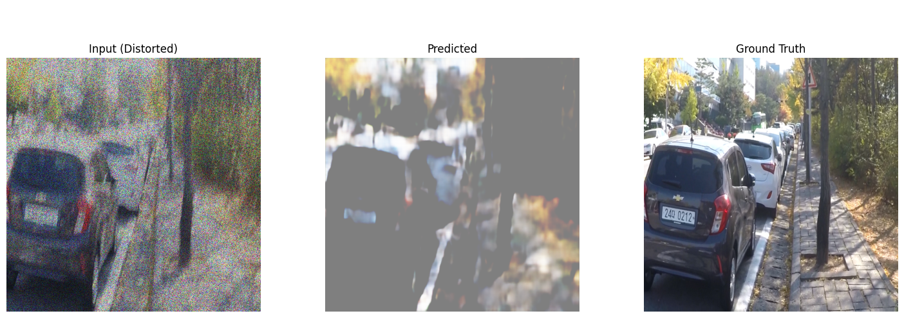
Visualizations - Experiment 2

Slide 28
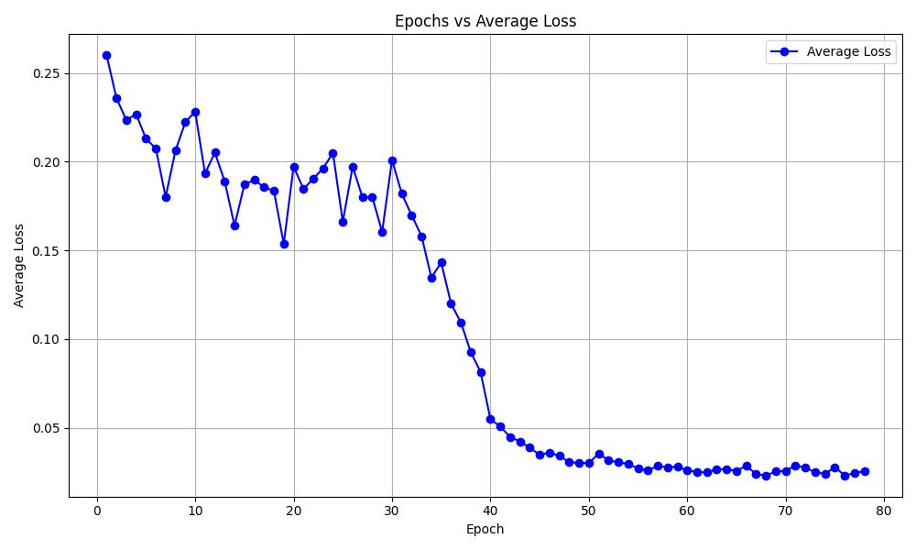
Visualizations - Experiment 2

Slide 29
Conclusion and Future Work

Slide 30
Conclusion
Remarks and summary
Experiment 1 performs better and is able to resolve all three artifacts.
“Fog” is observed in the generated output.
Probable cause of the “fog” is a shallow decoder.
Proposed model has achieved good PSNR and SSIM values.

Slide 31
Future Work and Next Steps
Experiment 3
We aim to perform an ablation study, experimenting with individual branches of the proposed architecture and including the results in the report.
Experiment 4
As an alternative approach to Experiment 2, we would compute the loss values on the complete image and not the patches by compromising the model complexity.
Report
Write the report and include all the findings.

Slide 32
References
Lingshun Kong, Jiawei Zhang, Dongqing Zou, Jimmy Ren, Xiaohe Wu, Jiangxin Dong, & Jinshan Pan. (2025). DeblurDiff: Real-World Image Deblurring with Generative Diffusion Models.
Kaihao Zhang, Wenqi Ren, Wenhan Luo, Wei-Sheng Lai, Bjorn Stenger, Ming-Hsuan Yang, & Hongdong Li. (2022). Deep Image Deblurring: A Survey.
Syed Waqas Zamir, Aditya Arora, Salman Khan, Munawar Hayat, Fahad Shahbaz Khan, & Ming-Hsuan Yang. (2022). Restormer: Efficient Transformer for High-Resolution Image Restoration.
Kaihao Zhang, Wenqi Ren, Wenhan Luo, Wei-Sheng Lai, Bjorn Stenger, Ming-Hsuan Yang, & Hongdong Li. (2022). Deep Image Deblurring: A Survey.
Seungjun Nah, Tae Hyun Kim, & Kyoung Mu Lee. (2018). Deep Multi-scale Convolutional Neural Network for Dynamic Scene Deblurring.
A. Abdelhamed, S. Lin and M. S. Brown, "A High-Quality Denoising Dataset for Smartphone Cameras," 2018 IEEE/CVF Conference on Computer Vision and Pattern Recognition, Salt Lake City, UT, USA, 2018, pp. 1692-1700, doi: 10.1109/CVPR.2018.00182

Slide 33
Thank you
Questions and Feedback

